Slide 1
Badger Remote Mouse
Yuye Wang, Xiufeng Xie, Chun Wang, Jack Chiu
11/12/2012

Slide 2
Agenda
Motivation
System Implementation
Challenges & Limitations
Summary
Our Application vs. Related Work
User Interface

Slide 3
Motivation

Slide 4
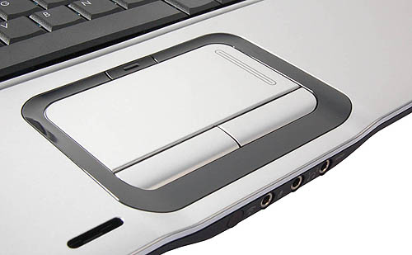
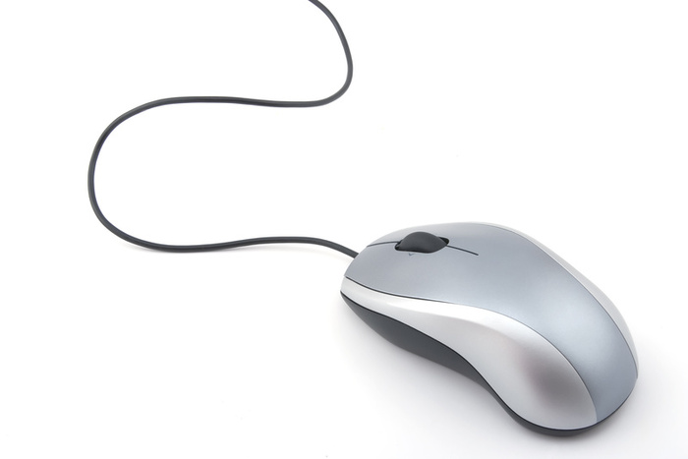
Motivation: 3D Mouse
Touchpads in notebook is not easy to use
Always bringing mouse is not convenient.
Traditional mouse needs a solid surface

Slide 5
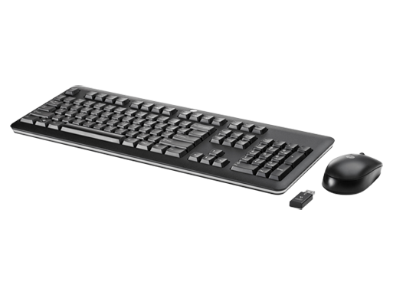
Motivation: Leg Control While Typing
Switch between keyboard and mouse
Keyboard typing takes both of your hands

Slide 6
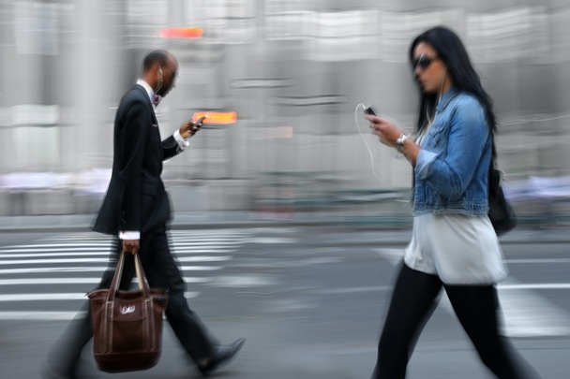
Motivation: Always at Hand
People will carry their phones all the time

Slide 7
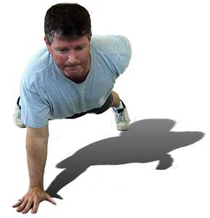
Motivation: Help disabled people
Also for people with hand disability
They can use their leg to control a PC

Slide 8
Our Application vs. Related Work

Slide 9
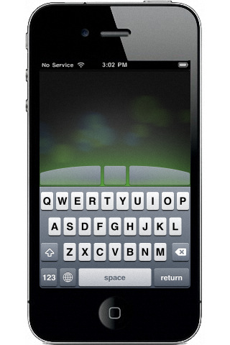
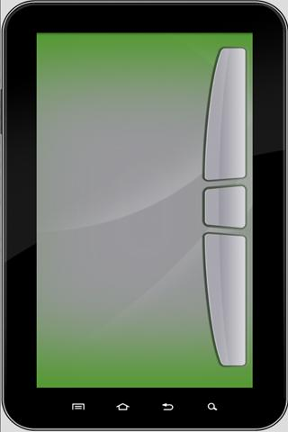
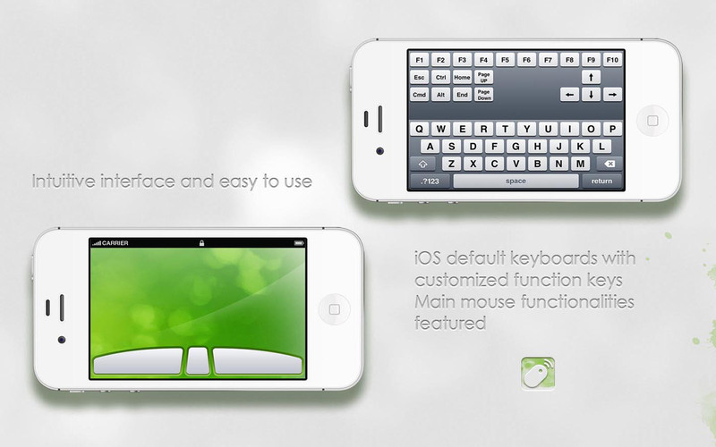
Related Work (i)
There are many remote mouse application
Most of them are for Android Phone/iPhone

Slide 10
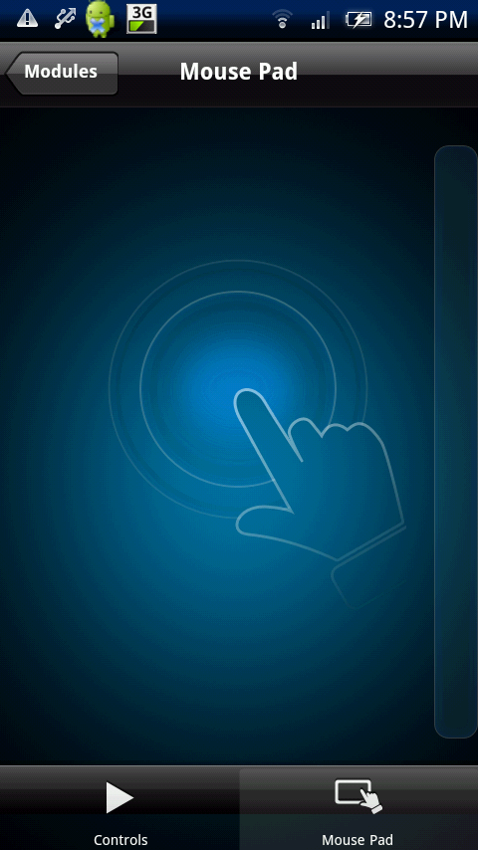
Related Work (ii)
Not so many for Windows Phone
Most are simply touchpad
Use touch screen on the phone as the touch pad

Slide 11
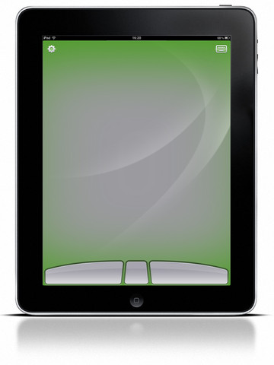
Our Work: Not Only A Touch Pad
Use the reading of the accelerometer and gyroscope on the phone to control mouse cursor
No need to use your finger

Slide 12

Our Work: Release Your Hand
Keep on typing, use your leg to control the mouse cursor
Programmers will be
happy about this
when busy typing

Slide 13
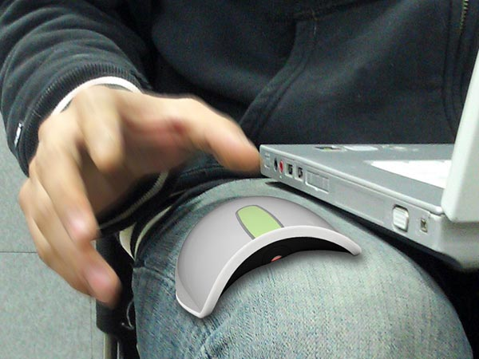
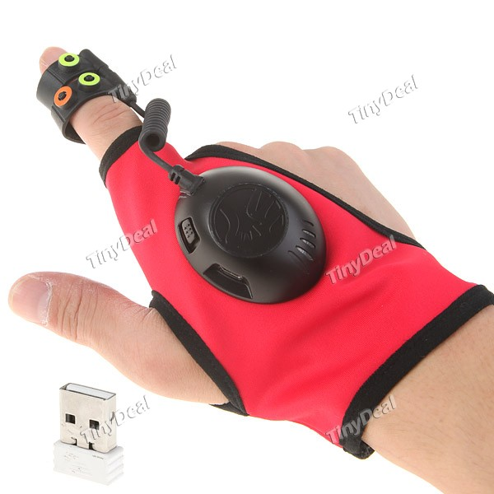
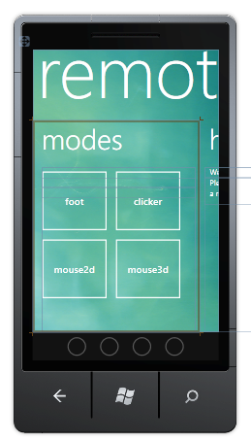
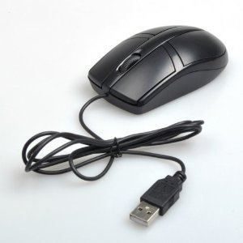
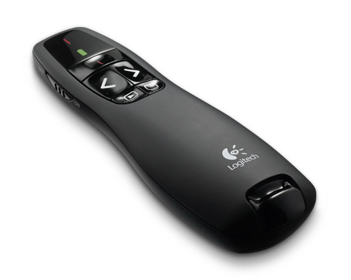
Our Work: Multiple Operation Modes
All in one
Leg Control
3D mouse
PPT clicker
2D mouse
Touchpad

Slide 14
Demo

Slide 15
User Interface

Slide 16
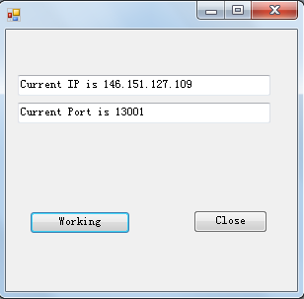
Server UI
Windows Form Application
More friendly to normal users
Windows Console
For debugging

Slide 17
Client UI
Main panorama
Home
Settings
Modes
Five functions
Leg Control
Clicker
2D mouse
3D mouse
Touch pad
Help pivots

Slide 18
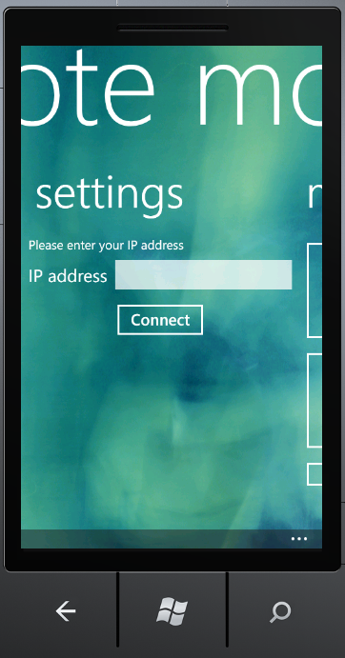
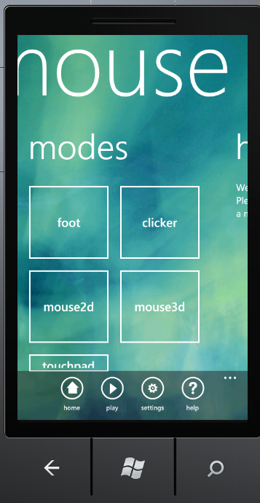
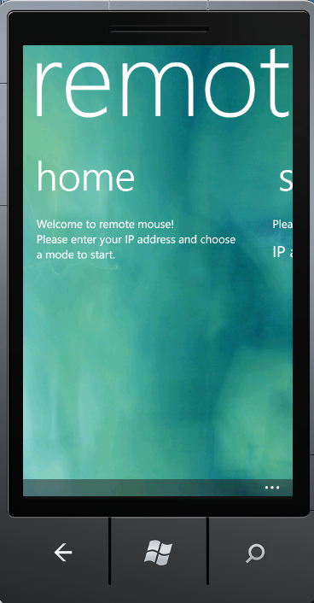
Panorama Page

Slide 19
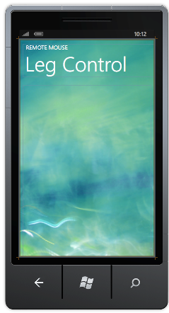
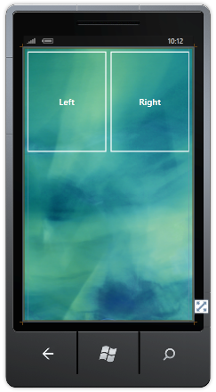
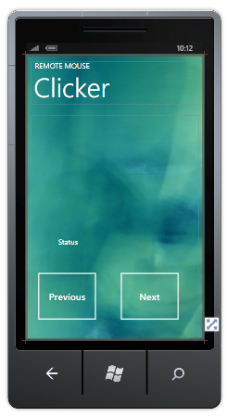
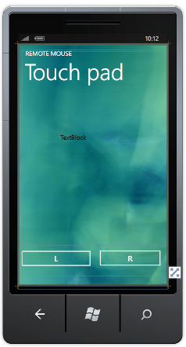
Functions Page

Slide 20
System Implementation

Slide 21
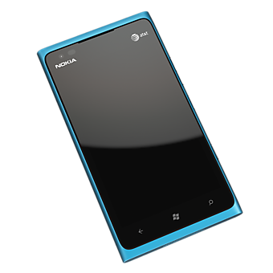
Update Sensor Data
Update sensor data periodically
Accelerometer
X-axis
Y-axis
Z-axis
Attitude
Yaw angle
Pitch angle
Roll angle

Slide 22
Prepare Data to Send
Pack sensor data and other control data (e.g. mouse button click control) into a data string
Header indicates operation mode
1: PPT clicker
2: 2D Mouse
3: 3D Mouse
4: Leg Control
5: Touch Pad

Slide 23
Send Data: How to send?
Send control data to the laptop (server)
Wi-Fi socket (UWNet will block our application)
TCP/IP
Set up your laptop as a virtual AP
Open “cmd” in administrator mode
Enter (example): netsh wlan set hostednetwork mode=allow ssid=xxf key=12345678
Enter: netsh wlan start hostednetwork
Shut down the virtual AP
Enter: netsh wlan stop hostednetwork

Slide 24
Send Data: When to send?
Send control data periodically?
Problem:
The application always crashes with the exception:
"An existing connection was forcibly closed by the remote host socket“
Why: Real-time application vs. Windows
If the server cannot deal with old data before new data come, the thread will be blocked, then the application crashes.

Slide 25
Send Data: Less Burden?
Transmit less data to server
Less digits for sensor data
Increase interval between transmissions
Each operation mode only transmit necessary data for its own functionality
Larger buffer in server side

Slide 26
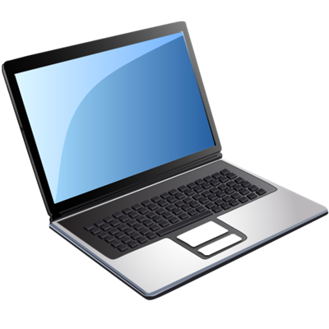
Send Data: Use Feedback
Press “Start”
Control Data
Unpredictable Processing Delay
Feedback
Receiving Feedback
Windows is not a real-time system

Slide 27
Send Data: Feedback Triggered
The sending frequency of control data will never exceed the processing ability of the server
Advantage
More stable
More fluent:
no need to be conservative for the worst case processing time

Slide 28
Laptop receive data from WP
Extract control parameters from received data string
Operation Mode
Accelerometer: X, Y, Z
Attitude: Yaw, Pitch, Roll
Mouse click indicator

Slide 29
Mode Selection
Server side program will figure out the operation mode base on the header of received data string.
1: PPT clicker
2: 2D Mouse
3: 3D Mouse
4: Leg Control
5: Touchpad

Slide 30
Smooth received sensor data
Ripple in sensor data:
unconscious movement
First order low pass filter

Slide 31
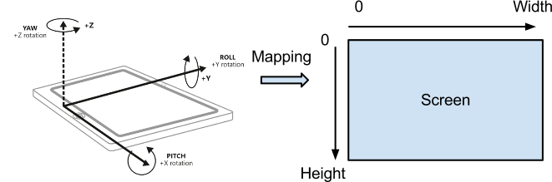
Sensor data cursor location
Mathematic model
Cursor location is (x,y)
x: location of cursor in the x-axis of the screen
y: location of cursor in the x-axis of the screen
Roll: smartphone rotation angle
Pitch: smartphone pitch angle

Slide 32
Linear Mapping Algorithm
X axis: use the rotation of the phone
Y axis: use the pitch up and down
are predetermined parameter

Slide 33
Design Mapping Parameters
Screen

Slide 34
Learning Algorithm
Problem
Users have different
bodies & habits
The range of sensor
reading will be different
Solution
Learning algorithm
Gather user data in the training phase
Use learnt data to update mapping parameters

Slide 35
Set mouse cursor to the position
Easy to implement using windows API
Import “user32.dill”
Get cursor position
Set cursor position
Mouse Events
Mouse button up & down
Mouse wheel

Slide 36
Simulate Mouse Button Click
Leg control
Set a threshold for acceleration
If acceleration on Z-axis (up/down) exceeds the threshold, perform left button click
If acceleration on X-axis (left/right) exceeds the threshold, perform right button click
Do not interfere with cursor position control, as long as you do it slow enough

Slide 37
Simulate Mouse Button Click
2D/3D mouse
Display mouse button on the touch screen of windows phone
Use “Tap” Event rather than “Click” Event
Double Tap
Pack mouse button click variable in the data string transmitted to the laptop
Laptop perform mouse click based on the received mouse button click variable.

Slide 38
Send feedback to smartphone
Transmit a data string back to the phone
In normal case, transmit “connected”
If mouse button is successfully clicked, transmit “clicked”
clicked

Slide 39
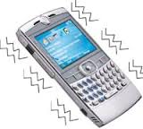
Phone gives feedback to user
After receiving the "clicked" signal from the server, WP will vibrate as a feedback that the button is successfully clicked.
On receiving the feedback, WP will send current sensor data and other control data to the server

Slide 40
System Diagram
Sensor Data
UI
Sensors
Control Position
Data String
Start/Pause
Client Socket
Server Socket
Control Click
Feedback
UI
Mode Selection
Extract Data
Mapping Algorithm
Control Data
LPF
Learning Algorithm

Slide 41
Challenges & Limitations

Slide 42
Selection of Click Threshold
Problem
Simulate mouse button click without interfering with cursor position control
Use acceleration on different axis to control click
Threshold to large: difficult to trigger click
Threshold to small: always interfere with position control

Slide 43
Feedback to User
Problem
Users want feed back
Physical button feedback:
Feeling on the hand
Click sound
No physical button in our application
Solution
Vibration after click
After a mouse button click, server sends a "clicked" signal back to WP.
After receiving the "clicked" signal, WP will vibrate.

Slide 44
Smooth Data
Problem
You thigh is not a stable platform
Sensor reading will ripple
Solution
A first order low pass filter is used to smooth sensor data
Eliminate the rippled caused by the inadvertent movement of users.

Slide 45
What is the proper place
Method | Phone location | User status | User behavior | Easy to use?
Hand control | At hand | No limit | Rotate phone with hand | Good
Thigh control | Tied above thigh | Sitting | Move thigh | Good
Ankle control | Tied above ankle | Sitting | Move ankle | Fair
Body control | Tied above ankle | Standing | Move body | Fair

Slide 46
Precision of the sensor
Sensors equipped on Windows Phone are not precise enough.
Use integration of acceleration, we cannot get current velocity of the phone.
Fatal for 2D mouse

Slide 47
Take away

Slide 48
Take away
Fast
Simple
User friendly
Integration

Slide 49
Summary

Slide 50
Thank you!

